Slide 1
Unit 4

Slide 2
Inheritance
Inheritance is an important concept of Object-Oriented Programming (OOP) in C++. It allows a new class to acquire the properties and behaviors of an existing class.
The existing class is called the Base Class (Parent Class).
The new class that inherits properties is called the Derived Class (Child Class).
Using inheritance, we can reuse code, reduce duplication, and create a hierarchical relationship between classes.
Basic Idea
If a class already contains some data members and functions, another class can reuse those features instead of writing them again.
Example concept:
Base Class: Vehicle
Derived Class: Car
The Car class automatically gets properties of Vehicle, such as speed, engine functions, etc.

Slide 3
General Syntax of Inheritance
class DerivedClass : access_specifier BaseClass { // additional members of derived class };
Access Specifier
The access specifier determines how the members of the base class are accessible in the derived class.

Slide 4
Advantages of Inheritance
Code Reusability Existing code can be reused without rewriting it.
Better Code Organization Programs can be structured in a hierarchical manner.
Easy Maintenance Changes in the base class automatically affect derived classes.
Extensibility New classes can easily be added.

Slide 5
Types of Inheritance in C++
There are five main types of inheritance in C++.
Single Inheritance
Multiple Inheritance
Multilevel Inheritance
Hierarchical Inheritance
Hybrid Inheritance

Slide 6
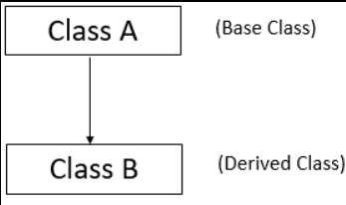
1. Single Inheritance
Single inheritance means one derived class inherits from one base class.
Example :
Base Class: Animal
Derived Class: Dog
Here Dog inherits properties of Animal.

Slide 7
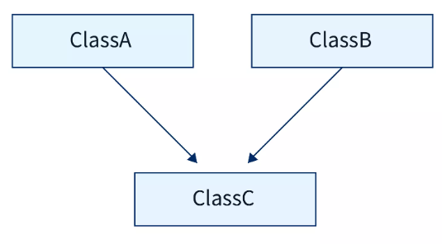
2. Multiple Inheritance
Multiple inheritance means one derived class inherits from more than one base class.
Example :
Base Class 1: Teacher
Base Class 2: Researcher
Derived Class: Professor
The Professor class inherits features of both Teacher and Researcher.

Slide 8
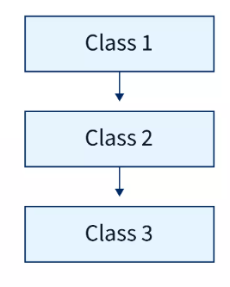
3. Multilevel Inheritance
Multilevel inheritance occurs when a class is derived from another derived class.
Example -
Base Class: Vehicle
Derived Class: Car inherits Vehicle
Further Derived Class: ElectricCar inherits Car
Notes:
Vehicle contains common features like speed, engine control, start(), stop().
Car inherits all features of Vehicle and may add numberOfDoors, airConditioning().
ElectricCar inherits all features of Car and may add batteryLevel, chargeBattery().

Slide 9
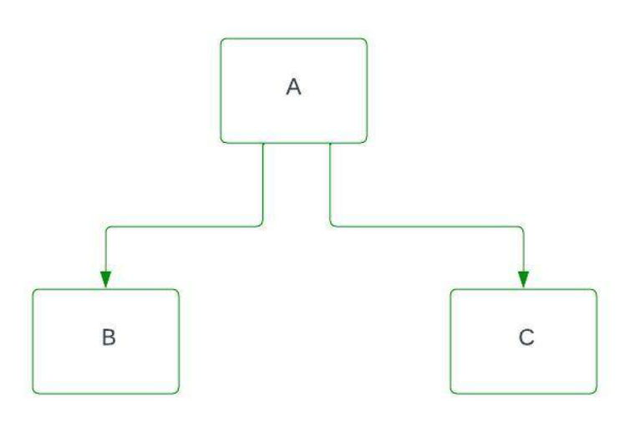
4. Hierarchical inheritance
Hierarchical inheritance is a type of inheritance in which one base class is inherited by two or more derived classes. All the derived classes share the common properties and functions of the same base class, but each derived class may also have its own additional features.
Example :
Base Class: Shape
Derived Classes: Circle, Rectangle, Triangle
All derived classes use features of Shape.

Slide 10
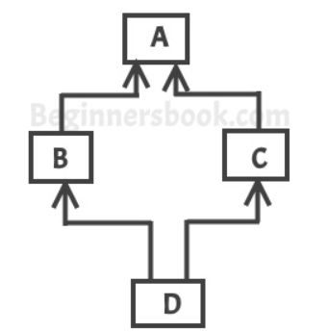
5. Hybrid Inheritance
Hybrid inheritance is a combination of two or more types of inheritance.
Example:
A combination of multiple inheritance and multilevel inheritance.

Slide 11
1. Single Inheritance
One class inherits from one base class.
Student → Marks
#include <iostream>
using namespace std;
class Student
{
public:
int roll;
void getRoll()
{
cout << "Enter Roll No: ";
cin >> roll;
}
};
class Marks : public Student
{
public:
int marks;
void getMarks()
{
cout << "Enter Marks: ";
cin >> marks;
}
void display()
{
cout << "Roll No: " << roll << endl;
cout << "Marks: " << marks << endl;
}
};
int main()
{
Marks m;
m.getRoll();
m.getMarks();
m.display();
}
Notes:
Student is the base class.
Marks is the derived class.
Marks automatically inherits roll and getRoll() from Student.
So we can directly use roll inside the derived class.

Slide 12
Base Class Member | After Public Inheritance
public | public
protected | protected
private | not accessible
Public Derivation
When a class is inherited using public, the access levels remain mostly the same.
Notes:
Because roll and getRoll() are public in Student (in previous example), and the inheritance is public, they remain public in the derived class Marks.
Therefore:
They can be used inside the derived class
They can also be accessed directly in main() using the object

Slide 13
Base Class Member | After Private Inheritance
public | private
protected | private
private | not accessible
Private Derivation
When inheritance is private, the base class members become more restricted.

Slide 14
Example –
#include <iostream>
using namespace std;
class Student
{
public:
int roll;
void getRoll()
{
roll = 101;
}
};
class Marks : private Student
{
public:
void show()
{
getRoll();
cout << "Roll No: " << roll << endl;
}
};
int main()
{
Marks m;
m.show();
}
Notes:
Student members become private inside Marks.
So they cannot be accessed directly in main().
They can only be used inside the derived class functions.

Slide 15
Protected Member
Protected members can be accessed inside derived classes but not outside the class.
Access Modifier | Same Class | Derived Class | Outside Class
private | Yes | No | No
protected | Yes | Yes | No
public | Yes | Yes | Yes

Slide 16
Example –
#include <iostream>
using namespace std;
class Student
{
protected:
int roll;
public:
void getRoll()
{
roll = 101;
}
};
class Marks : public Student
{
public:
void display()
{
cout << "Roll No: " << roll << endl;
}
};
int main()
{
Marks m;
m.getRoll();
m.display();
}
Notes:
roll is protected in Student.
It cannot be accessed directly in main().
But it can be used inside the derived class.
This is why protected is commonly used in inheritance.

Slide 17
Base Class Member | After Protected Inheritance
public | protected
protected | protected
private | not accessible
Protected Derivation
In protected inheritance, the public and protected members of the base class become protected in the derived class.

Slide 18
#include <iostream>
using namespace std;
class Student
{
public:
int roll;
void getRoll()
{
roll = 101;
}
};
class Marks : protected Student
{
public:
void display()
{
getRoll(); // allowed
cout << "Roll No: " << roll << endl;
}
};
int main()
{
Marks m;
m.display();
}
Notes:
Explanation
In the Student class
roll → public
getRoll() → public
But because inheritance is protected
class Marks : protected Student
They become protected inside Marks.
So they can be used: Inside the derived class
getRoll(); cout << roll;
But they cannot be accessed directly in main()
For example, this would cause an error:
m.getRoll(); // not allowed cout << m.roll; // not allowed
Because they are now protected members of Marks.

Slide 19
Constructor in Derived Class When a derived class object is created, the base class constructor runs first, then the derived class constructor runs.
Execution order: Base Constructor ↓ Derived Constructor

Slide 20
#include <iostream>
using namespace std;
class Student
{
public:
Student()
{
cout << "Student Constructor Called" << endl;
}
};
class Marks : public Student
{
public:
Marks()
{
cout << "Marks Constructor Called" << endl;
}
};
int main()
{
Marks m;
}
Output
Student Constructor Called Marks Constructor Called
Notes:
Explanation
When object m is created:
Base class constructor executes first
Then derived class constructor executes
This ensures base class initialization happens first.

Slide 21
How Base Class Constructor is Called
A base class constructor can be called in two ways:
Automatically (Default Constructor)
Explicitly using Initializer List
General syntax:
Derived(parameters) : Base(arguments) { // body of derived constructor }
Case 1: Base Class has Default Constructor – Already covered in previous example

Slide 22
Case 2: Base Class has Parameterized Constructor
If the base class constructor requires parameters, the derived class must explicitly call it using initializer list.
#include <iostream>
using namespace std;
class Student
{
protected:
int roll;
public:
Student(int r)
{
roll = r;
cout << "Student Constructor Called" << endl;
}
};
class Marks : public Student
{
private:
int marks;
public:
Marks(int r, int m) : Student(r)
{
marks = m;
cout << "Marks Constructor Called" << endl;
}
void display()
{
cout << "Roll No: " << roll << endl;
cout << "Marks: " << marks << endl;
}
};
int main()
{
Marks m(101, 90);
m.display();
}
Notes:
Output
Student Constructor Called Marks Constructor Called Roll No: 101 Marks: 90
Explanation
Student(r) in the initializer list calls the base class constructor before the derived constructor executes.

Slide 23
Case 3: Base Class Has Both Default and Parameterized Constructors
If both constructors exist, then:
Default constructor is called automatically.
Parameterized constructor can be called explicitly.
#include <iostream>
using namespace std;
class Student
{
public:
Student()
{
cout << "Default Student Constructor" << endl;
}
Student(int r)
{
cout << "Parameterized Student Constructor: " << r << endl;
}
};
class Marks : public Student
{
public:
Marks()
{
cout << "Marks Constructor" << endl;
}
};
int main()
{
Marks m;
}
If we want the parameterized constructor:
class Marks : public Student { public: Marks() : Student(101) { cout << "Marks Constructor" << endl; } };

Slide 24
Case 4: Base Class Has Only Parameterized Constructor (No Default)
If the base class has no default constructor, then the derived class must call the base constructor explicitly.
Otherwise the program will produce a compile-time error.

Slide 25
Destructor in Derived Class
When an object is destroyed, destructors run in reverse order.
Execution order:
Derived Destructor ↓ Base Destructor

Slide 26
#include <iostream>
using namespace std;
class Student
{
public:
~Student()
{
cout << "Student Destructor Called" << endl;
}
};
class Marks : public Student
{
public:
~Marks()
{
cout << "Marks Destructor Called" << endl;
}
};
int main()
{
Marks m;
}
Output
Marks Destructor Called Student Destructor Called
Notes:
Explanation
When program ends:
Derived class destructor executes first
Then base class destructor executes
This ensures derived class resources are released before base class resources.

Slide 27
Multilevel Inheritance –
Multilevel inheritance occurs when a class is derived from another derived class. This creates a chain of inheritance.
Structure:
Base Class → Derived Class → Further Derived Class
Each derived class inherits the properties of all the classes above it.
Example structure:
Student → Marks → Result
Student → Base class
Marks → Derived from Student
Result → Derived from Marks
Here Result inherits properties of both Marks and Student.

Slide 28
#include <iostream>
using namespace std;
class Student
{
protected:
int roll;
public:
void getRoll()
{
cout << "Enter Roll No: ";
cin >> roll;
}
};
class Marks : public Student
{
protected:
int marks;
public:
void getMarks()
{
cout << "Enter Marks: ";
cin >> marks;
}
};
class Result : public Marks
{
public:
void display()
{
cout << "Roll No: " << roll << endl;
cout << "Marks: " << marks << endl;
}
};
int main()
{
Result r;
r.getRoll();
r.getMarks();
r.display();
}
Notes:
Constructor Execution Order
If constructors are used, execution order is:
Student Constructor ↓ Marks Constructor ↓ Result Constructor
Because inheritance follows top-to-bottom order.
Destructor Order
Destructors execute in reverse order:
Result Destructor ↓ Marks Destructor ↓ Student Destructor
Advantages of Multilevel Inheritance
Code Reusability Classes reuse features of previous classes.
Hierarchical Structure Programs become well organized.
Easy Extension New functionality can be added in further derived classes.
Diagram (Concept)
Student │ │ Marks │ │ Result
Key Points for Exams
Multilevel inheritance means inheritance chain of classes.
A derived class inherits all accessible members of its parent class.
Constructors execute from base to derived.
Destructors execute from derived to base.
If you want, I can also show a slightly better multilevel example used in most textbooks:
Student → Test → Sports → Result
This example also helps students understand how marks from multiple sources combine, and it is commonly asked in university exams.

Slide 29
Multiple Inheritance –
Multiple inheritance occurs when one derived class inherits from more than one base class.
Structure:
Base Class 1 \ \ Derived Class / / Base Class 2
In this case, the derived class gets properties and functions from multiple base classes.
Example Structure
Student Sports \ / Result
Student → Base class
Sports → Base class
Result → Derived class
The Result class inherits features from both Student and Sports.
Syntax of Multiple Inheritance
class DerivedClass : access BaseClass1, access BaseClass2 { };
Example:

Slide 30
cout << "Enter Marks: ";
cin >> marks;
}
};
class Result : public Student, public Marks
{
public:
void display()
{
cout << "Roll No: " << roll << endl;
cout << "Marks: " << marks << endl;
}
};
int main()
{
Result r;
r.getRoll();
r.getMarks();
r.display();
}
#include <iostream>
using namespace std;
class Student
{
protected:
int roll;
public:
void getRoll()
{
cout << "Enter Roll No: ";
cin >> roll;
}
};
class Marks
{
protected:
int marks;
public:
void getMarks()
{

Slide 31
Ambiguity Resolution (Multiple Inheritance) –
Ambiguity occurs in C++ when two base classes contain a member with the same name, and the derived class inherits from both of them.
When the derived class tries to access that member, the compiler cannot determine which base class member should be used. This situation is called ambiguity.
Example Structure -
Class A Class B \ / \ / Class C
If Class A and Class B contain a function with the same name, then Class C inherits two versions of that function, causing confusion.

Slide 32
Example Problem –
#include <iostream>
using namespace std;
class Marks
{
public:
void show()
{
cout << "Marks class function" << endl;
}
};
class Comments
{
public:
void show()
{
cout << "Comments class function" << endl;
}
};
class Result : public Marks, public Comments
{
};
int main()
{
Result r;
r.show(); // ambiguity occurs here
}
Notes:
Error Explanation
The compiler finds two possible functions:
Marks::show() Comments::show()
So when we write
r.show();
the compiler does not know which function should be called, resulting in ambiguity error.

Slide 33
Resolving Ambiguity Using Scope Resolution Operator
The ambiguity can be resolved using the scope resolution operator ::.
Correct Program
#include <iostream>
using namespace std;
class Marks
{
public:
void show()
{
cout << "Marks class function" << endl;
}
};
class Comments
{
public:
void show()
{
cout << "Comments class function" << endl;
}
};
class Result : public Marks, public Comments
{
};
int main()
{
Result r;
r.Marks::show();
r.Comments::show();
}
Notes:
Explanation
Here we explicitly specify which class function should be called.
r.Marks::show();
calls the function from the Marks class.
r.Comments::show();
calls the function from the Comments class.
Thus the scope resolution operator removes the ambiguity.

Slide 34
Hierarchical Inheritance –
Hierarchical inheritance occurs when multiple derived classes inherit from the same base class.
Structure:
Base Class / \ Derived Class1 Derived Class2
Each derived class inherits the properties and functions of the same base class.
Example Structure
Student / \ Marks Comments
Student → Base class
Marks → Derived class
Comments → Derived class
Both Marks and Comments inherit the features of Student.

Slide 35
#include <iostream>
using namespace std;
class Student
{
protected:
int roll;
public:
void getRoll()
{
cout << "Enter Roll No: ";
cin >> roll;
}
};
class Marks : public Student
{
private:
int marks;
public:
void getMarks()
{
cout << "Enter Marks: ";
cin >> marks;
}
void displayMarks()
{
cout << "Roll No: " << roll << endl;
cout << "Marks: " << marks << endl;
}
};

Slide 36
class Comments : public Student
{
private:
string comment;
public:
void getComment()
{
cout << "Enter Comment: ";
cin >> comment;
}
void displayComment()
{
cout << "Roll No: " << roll << endl;
cout << "Comment: " << comment << endl;
}
};
int main()
{
Marks m;
Comments c;
m.getRoll();
m.getMarks();
m.displayMarks();
cout << endl;
c.getRoll();
c.getComment();
c.displayComment();
}

Slide 37
Hybrid Inheritance –
Hybrid inheritance is a combination of two or more types of inheritance.
It usually combines:
Multiple inheritance
Multilevel inheritance
Hierarchical inheritance
Hybrid inheritance is used when a program requires multiple inheritance structures together.
Structure Example
A common hybrid inheritance structure is:
Student / \ Marks Sports \ / Result
This structure combines:
Hierarchical inheritance Student → Marks Student → Sports
Multiple inheritance Marks + Sports → Result
Therefore this becomes Hybrid Inheritance.

Slide 38
#include <iostream>
using namespace std;
class Student
{
protected:
int roll;
public:
void getRoll()
{
cout << "Enter Roll No: ";
cin >> roll;
}
};
class Marks : public Student
{
protected:
int marks;
public:
void getMarks()
{
cout << "Enter Marks: ";
cin >> marks;
}
};

Slide 39
class Sports : public Student
{
protected:
int score;
public:
void getScore()
{
cout << "Enter Sports Score: ";
cin >> score;
}
};
class Result : public Marks, public Sports
{
public:
void display()
{
cout << "Roll No: " << Marks::roll << endl;
cout << "Marks: " << marks << endl;
cout << "Sports Score: " << score << endl;
}
};
int main()
{
Result r;
r.Marks::getRoll();
r.getMarks();
r.getScore();
r.display();
}
Notes:
Ambiguity in Hybrid Inheritance
Because both Marks and Sports inherit Student, the Result class receives two copies of Student.
Therefore accessing roll becomes ambiguous.
To solve this we specify:
Marks::roll
or
Sports::roll

Slide 40
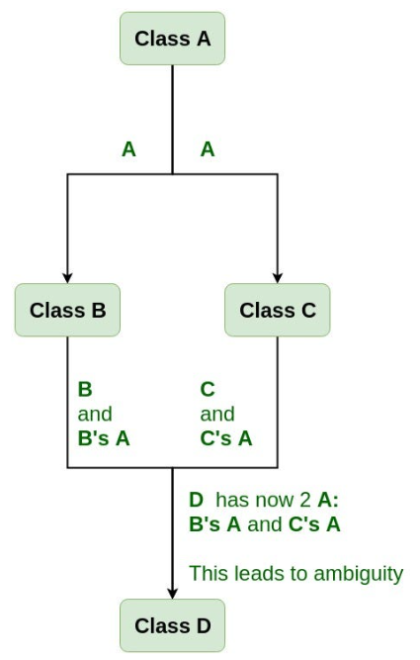
Virtual Base Class-
A virtual base class in C++ is used to solve the diamond problem in multiple inheritance. It ensures that only one copy of a base class is inherited, even if multiple paths exist.
Class B and C both inherit from A
Class D inherits from both B and C
Now D gets two copies of A → ambiguity

Slide 41
Without Virtual Base Class (Problem Code) –
#include <iostream>
using namespace std;
class A {
public:
int x;
};
class B : public A {};
class C : public A {};
class D : public B, public C {};
int main() {
D obj;
obj.x = 10; // Error: ambiguous
}
Compiler gets confused: Should x come from B→A or C→A?

Slide 42
Solution: Virtual Base Class
We use virtual keyword while inheriting:
class B : virtual public A {}; class C : virtual public A {};
virtual ensures only one shared copy of base class A
With Virtual Base Class (Correct Code)
#include <iostream> using namespace std; class A { public: int x; }; class B : virtual public A {}; class C : virtual public A {}; class D : public B, public C {}; int main() { D obj; obj.x = 10; // No ambiguity cout << obj.x; }
Notes:
virtual ensures only one shared copy of base class A
D now has one A, not two

Slide 43
Constructor Behavior –
Virtual base class constructor is called only once, by the most derived class
#include <iostream>
using namespace std;
class A {
public:
A() {
cout << "A constructor\n";
}
};
class B : virtual public A {
public:
B() {
cout << "B constructor\n";
}
};
class C : virtual public A {
public:
C() {
cout << "C constructor\n";
}
};
class D : public B, public C {
public:
D() {
cout << "D constructor\n";
}
};
int main() {
D obj;
}
Notes:
Output:
A constructor B constructor C constructor D constructor
Even though B and C inherit A, A runs only once

Slide 44
When to Use Virtual Base Class
Use it when:
Multiple inheritance exists
Same base class appears multiple times
You want to avoid duplication & ambiguity

Slide 45
#include <iostream>
using namespace std;
class Student
{
protected:
int roll;
public:
void getRoll()
{
cout << "Enter Roll No: ";
cin >> roll;
}
};
class Marks : virtual public Student
{
protected:
int marks;
public:
void getMarks()
{
cout << "Enter Marks: ";
cin >> marks;
}
};

Slide 46
class Sports : virtual public Student
{
protected:
int score;
public:
void getScore()
{
cout << "Enter Sports Score: ";
cin >> score;
}
};
class Result : public Marks, public Sports { public: void display() { cout << "Roll No: " << roll << endl; // no ambiguity cout << "Marks: " << marks << endl; cout << "Sports Score: " << score << endl; } };
int main() { Result r; r.getRoll(); // only one Student now r.getMarks(); r.getScore(); r.display(); }

Slide 47
Object Slicing –
Object slicing happens when a derived class object is assigned to a base class object, and the extra (derived) part is “sliced off”.
Only the base class portion remains, derived data is lost.
Think like:
Derived object = Base + Extra data (from derived class)
After slicing → only Base part survives

Slide 48
Example 1 –
#include <iostream>
using namespace std;
class Base {
public:
int x;
};
class Derived : public Base {
public:
int y;
};
int main() {
Derived d;
d.x = 10;
d.y = 20;
Base b = d; // ⚠️ Object slicing happens
cout << b.x << endl; // 10
// cout << b.y; Error (y is sliced off)
}
Notes:
What Happened?
d has → x and y
b gets → only x
y is lost permanently

Slide 49
Example 2: Function Parameter Slicing –
#include <iostream>
using namespace std;
class Base {
public:
void show() {
cout << "Base class\n";
}
};
class Derived : public Base {
public:
void show() {
cout << "Derived class\n";
}
};
void display(Base obj) { // ⚠️ slicing here
obj.show();
}
int main() {
Derived d;
display(d);
}
Notes:
Output:
Base class
Why not "Derived class"?
Because:
d is passed by value
It becomes a Base object
Derived part is sliced

Slide 50
Pointer to Base and Derived Class –
In inheritance:
A base class pointer can point to a derived class object
But access is limited to base class members only
Base Pointer → Derived Object (Allowed )
#include <iostream>
using namespace std;
class Base {
public:
int x;
void showBase() {
cout << "Base function\n";
}
};
class Derived : public Base {
public:
int y;
void showDerived() {
cout << "Derived function\n";
}
};
int main() {
Derived d;
Base *ptr;
ptr = &d; // Allowed
ptr->x = 10; // OK (Base member)
ptr->showBase(); // OK
// ptr->y = 20; Not allowed
// ptr->showDerived(); Not allowed
}
Notes:
Even though pointer is pointing to Derived, it behaves like Base pointer
Access allowed = Base members only

Slide 51
Derived Pointer → Base Object (Not Allowed )
Example 2
int main() { Base b; Derived *ptr; ptr = &b; // Error }
Using Type Casting -
You can force it using casting:
Derived *ptr = (Derived*)&b; // Dangerous
But this is unsafe May lead to garbage values / crash

Slide 52
Example 2 –
class Base {
public:
void show() {
cout << "Base show\n";
}
};
class Derived : public Base {
public:
void show() {
cout << "Derived show\n";
}
};
int main() {
Derived d;
Base *ptr = &d;
ptr->show(); // Which one? - Base show
}
Notes:
Function call is decided by pointer type
Pointer is Base*
So Base function is called

Slide 53
Virtual Function –
A virtual function is a member function of a base class that is redefined in derived class and is called based on object type (not pointer type).
Virtual function enables runtime decision of which function to call
Why Virtual Function is Needed?
From previous topic:
Base *ptr; Derived d; ptr = &d; ptr->show(); // calls Base function
Problem: Even though object is Derived, still Base function is called
Solution: Virtual Function
We use virtual keyword in base class

Slide 54
Example 1: Without Virtual Function -
#include <iostream> using namespace std; class Base { public: void show() { cout << "Base show\n"; } }; class Derived : public Base { public: void show() { cout << "Derived show\n"; } }; int main() { Base *ptr; Derived d; ptr = &d; ptr->show(); // Base show }

Slide 55
Example 2: With Virtual Function
#include <iostream> using namespace std; class Base { public: virtual void show() { // virtual cout << "Base show\n"; } }; class Derived : public Base { public: void show() { cout << "Derived show\n"; } }; int main() { Base *ptr; Derived d; ptr = &d; ptr->show(); // Derived show }
Notes:
Now function call depends on object type (Derived) Not on pointer type

Slide 56
Example 3: Multiple Derived Classes
#include <iostream>
using namespace std;
class Shape {
public:
virtual void draw() {
cout << "Drawing Shape\n";
}
};
class Circle : public Shape {
public:
void draw() {
cout << "Drawing Circle\n";
}
};
class Rectangle : public Shape {
public:
void draw() {
cout << "Drawing Rectangle\n";
}
};
int main() {
Shape *ptr;
Circle c;
Rectangle r;
ptr = &c;
ptr->draw(); // Circle
ptr = &r;
ptr->draw(); // Rectangle
}
Notes:
Output:
Drawing Circle Drawing Rectangle

Slide 57
Important Rules
Rule 1:
Virtual function must be in base class
Rule 2:
Call should be through base class pointer
Rule 3:
Function name & parameters must be same
Rule 4:
If you call using object:
Derived d; d.show(); // No virtual concept here
It will directly call derived function

